Slide 1

PARUL UNIVERSITY PARUL INSTITUTE OF TECHNOLOGY
Session: 2024-25
DEPARTMENT OF COMPUTER SCIENCE AND ENGINEERING
CERTIFICATE:
This is to certify that Mukund Raj, Nikhil Patidar, And Priyanshu Singh Students Of CSE 6th “Parul Institute Of Technology, Vadodara” Has Completed Their Minor Project Titled “Being Traveler” As Per The Syllabus And Has Submitted The a satisfactory Report As partial Fulfilment Of Towards The Award Of Degree Of Bachelor Of Technology In Computer Science And Engineering Under Parul University,
Vadodara, Gujarat(India)
Janhvi Dave Prof. Sumitra Menaria Dr. Swapnil Parikh
(Project Guide) Head( CSE) Principle
(CSE/IT) PIT Vadodara PIT, Vadodara

Slide 2
Being Traveler Minor Project Report Submitted In Partial Fulfillment of The Required for The Degree Of Bachelor Of Engineering In Computer Science & Engineering.
PARUL UNIVERSITY VADODARA, GUJARAT(INDIA)
Submitted By:
Mukund Raj (2203051050360)
Nikhil Patidar (2203051050374)
Priyanshu Singh (2203051050444)
Under The Guidance Of :
Janhvi Dave
CSE/IT
DEPARTMENT OF COMPUTER SCIENCE AND ENGINEERING
PARUL INSTITUTE OF TECHNOLOGY VADODARA, GUJARAT
SESSION: 2024-25

Slide 3
| Being Traveler
INTRODUCTION:-
The Being Traveler project is a comprehensive travel and tourism platform designed to simplify travel planning and booking experiences for users. This website provides a seamless and intuitive interface for travelers to explore destinations, book tour packages, and manage their travel plans efficiently. The project aims to enhance user engagement by offering a well-structured and feature-rich online travel solution with an emphasis on Indian destinations.
DEPARTMENT OF COMPUTER SCIENCE & ENGINEERING, PIT VADODARA

Slide 4
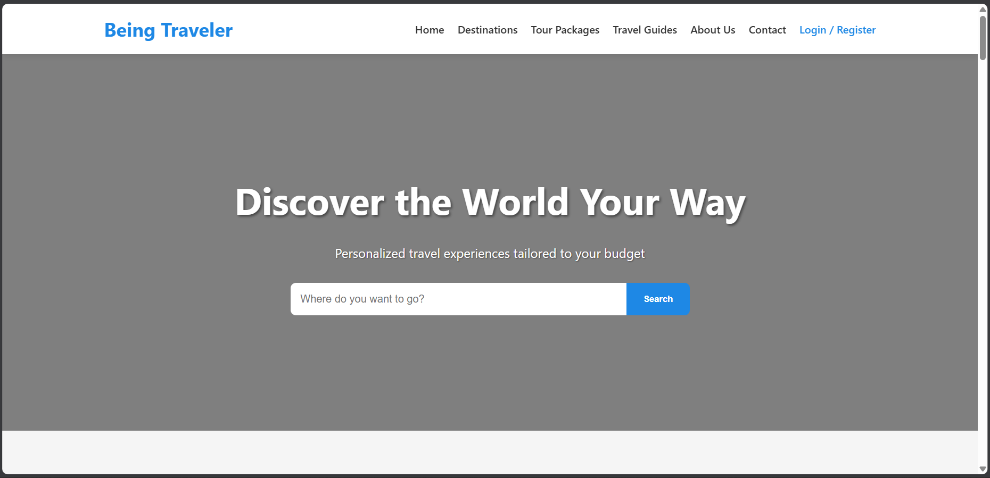
| Being Traveler
PROJECT OBJECTIVE:-
The key objectives of the Being Traveler project are:
User-Friendly Experience: Create an intuitive platform where users can search for travel destinations, view packages, and book trips with ease.

Slide 5
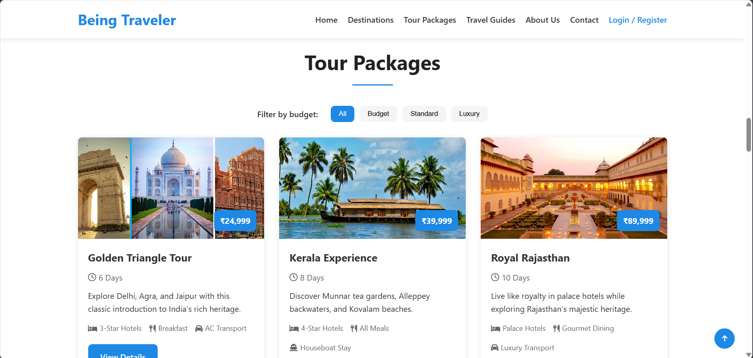
| Being Traveler
Comprehensive Tour Packages: Provide diverse tour packages with customizable options, catering to different budgets and preferences.

Slide 6
| Being Traveler
Secure Authentication and Booking System: Implement robust authentication and booking mechanisms to ensure a safe and seamless experience for users.
Admin and User Dashboards: Facilitate easy management of bookings, user profiles, and travel packages through dedicated dashboards.
Scalability and Performance: Develop a scalable architecture that can support future expansions, including multi-language support and mobile applications.
Integration with Payment Gateways: Enable secure and efficient online payments for bookings.
Advanced Search and Recommendation: Implement intelligent search filters and AI-driven recommendations for personalized travel suggestions.
DEPARTMENT OF COMPUTER SCIENCE & ENGINEERING, PIT VADODARA

Slide 7
| Being Traveler
PROJECT OVERVIEW:-
Project Name: Being Traveler - Travel Tourism Website
Start Date: 9/01/2025
Current Status: In Development
Completion: Approximately 60%

Slide 8
| Being Traveler
Completed Components:-
Frontend Development
Landing Page
Responsive hero section with search functionality
Features section highlighting key benefits
Popular destinations showcase (focused on Indian locations)
Tour packages section with budget filtering
Testimonials section with slider
Newsletter subscription integration
Contact form for user inquiries
Footer with site navigation links

Slide 9
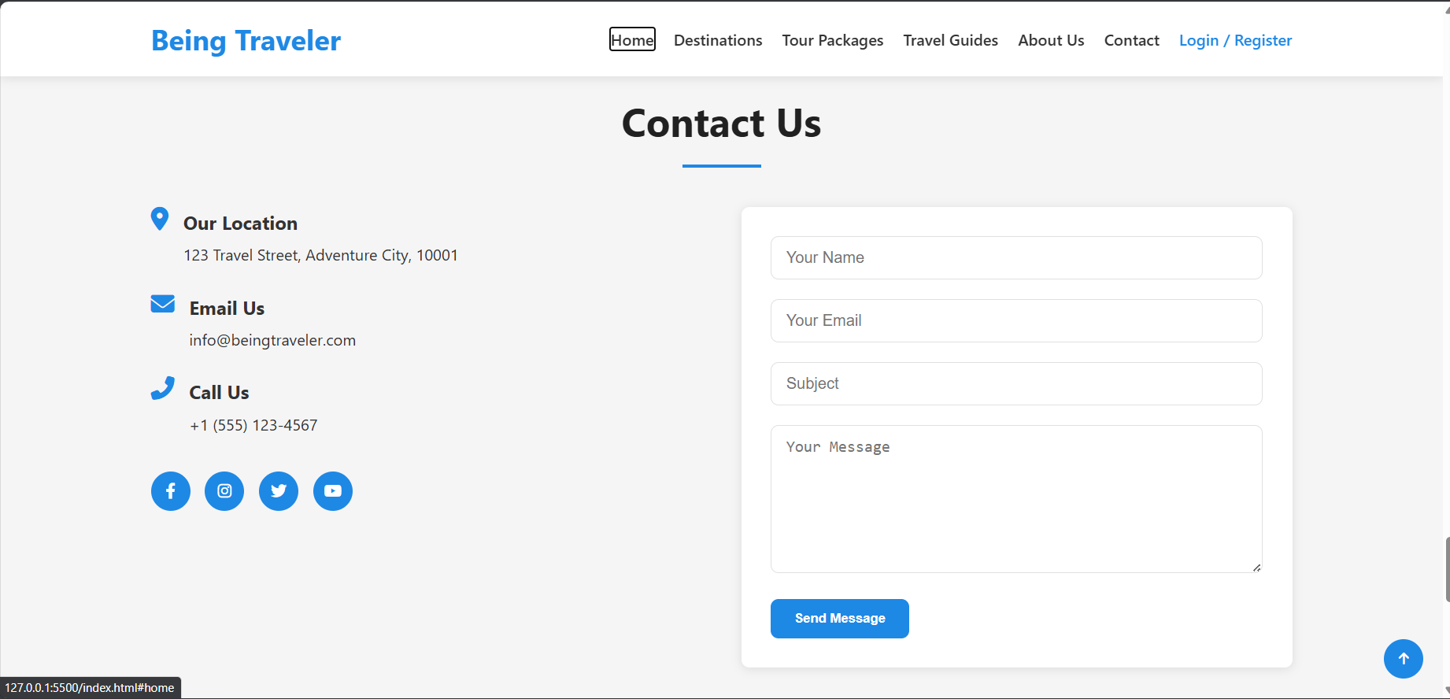
| Being Traveler

Slide 10
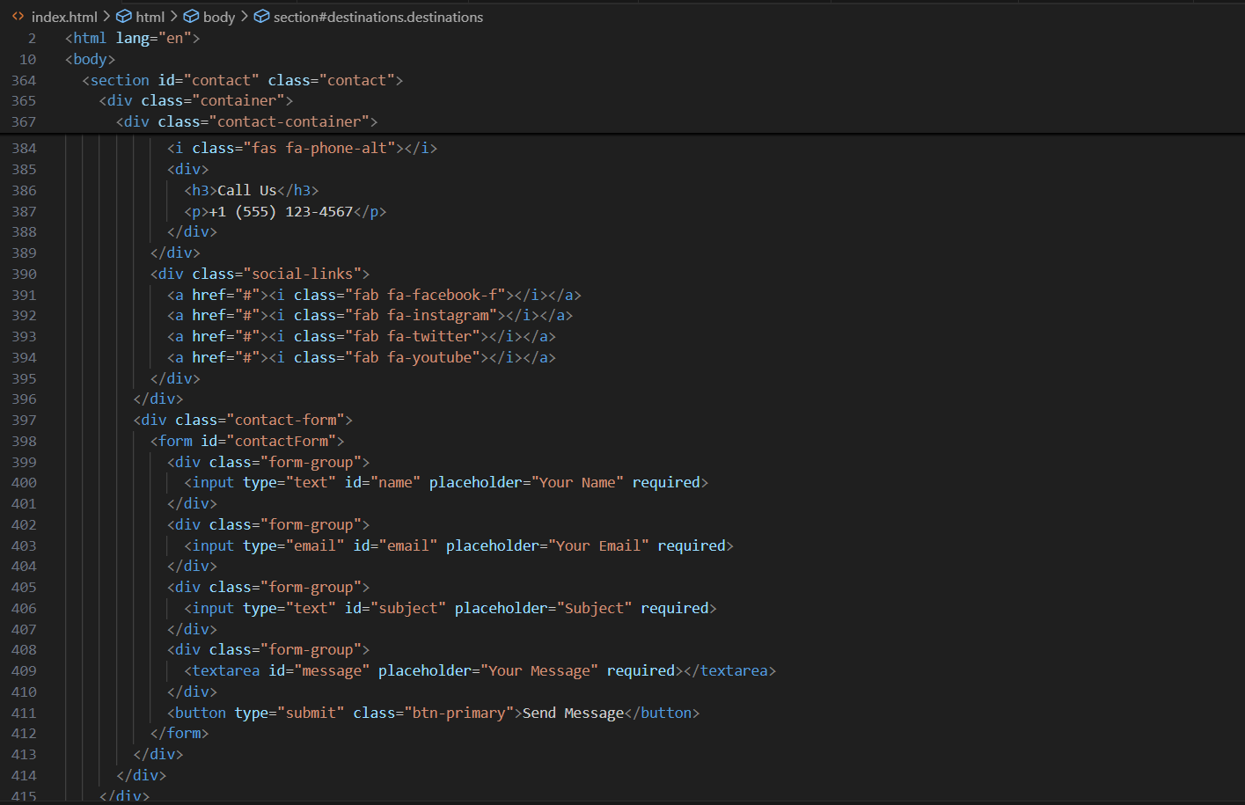
| Being Traveler

Slide 11
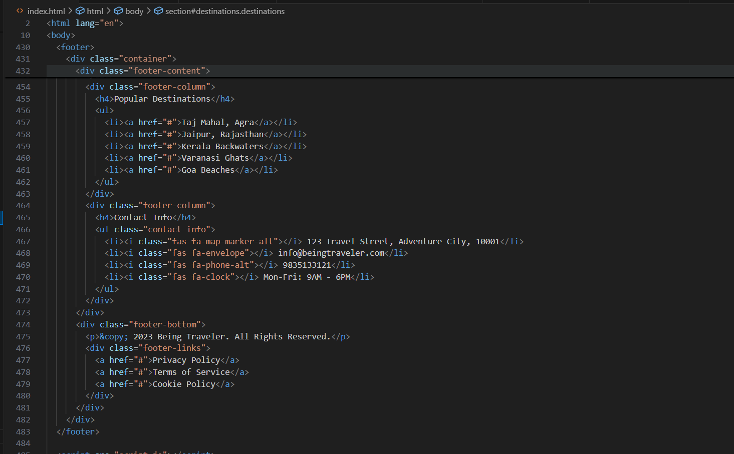
| Being Traveler

Slide 12
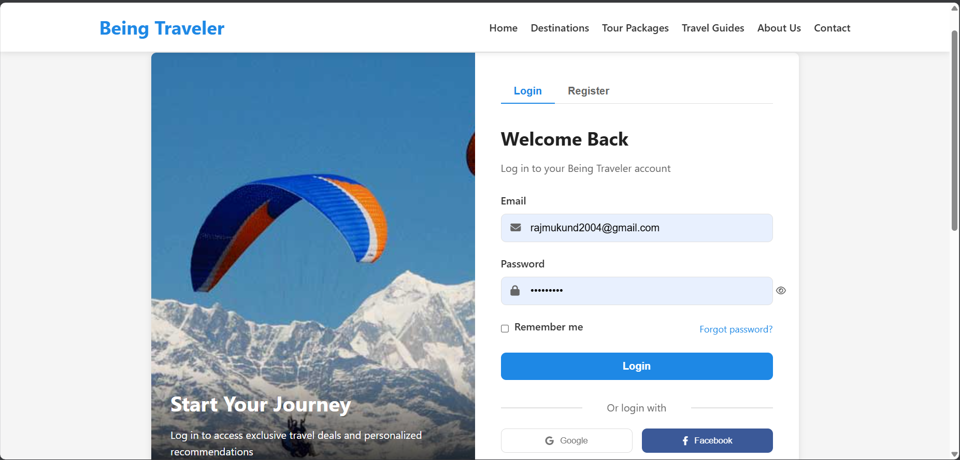
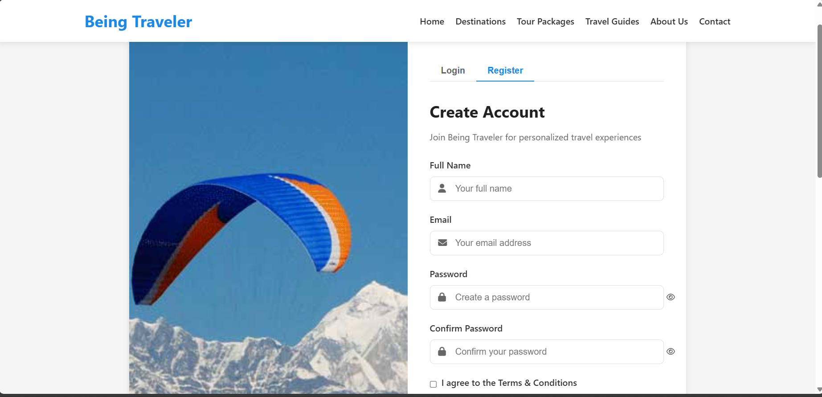
| Being Traveler
Authentication UI
Login page with email/password authentication
Registration form with validation
Password recovery interface
Social login options (UI only, backend pending)

Slide 13
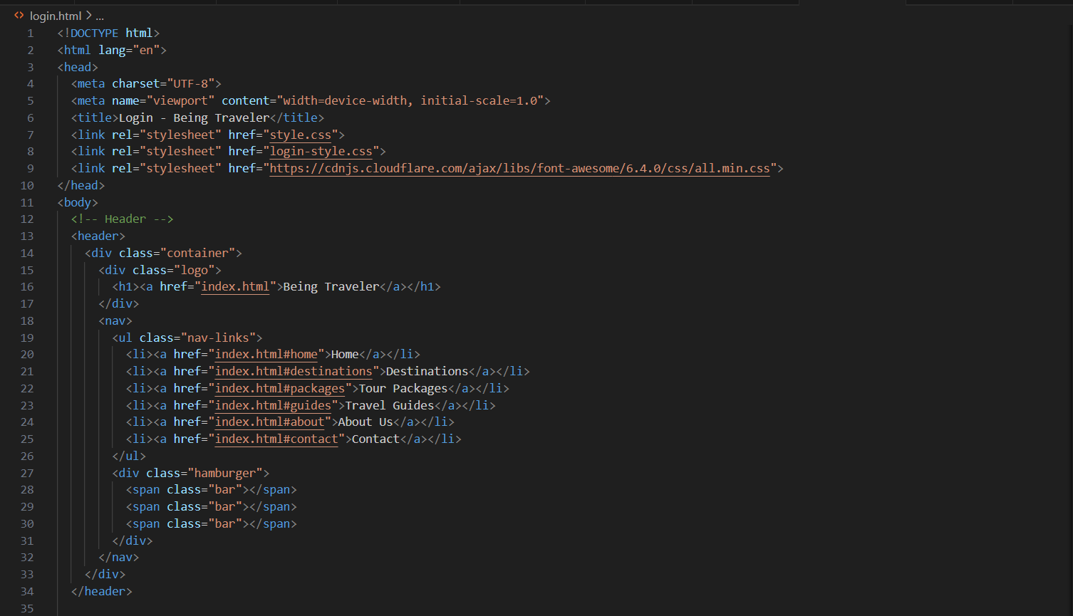
| Being Traveler

Slide 14
| Being Traveler
UI Components:-
Responsive navigation with mobile menu
Package filtering system
Testimonial slider
Form components with validation

Slide 15
| Being Traveler
Backend Development:-
Server Setup
Express.js server configuration
MongoDB database connection
Middleware integration (CORS, body parsing, error handling, etc.)
Centralized error handling implementation

Slide 16
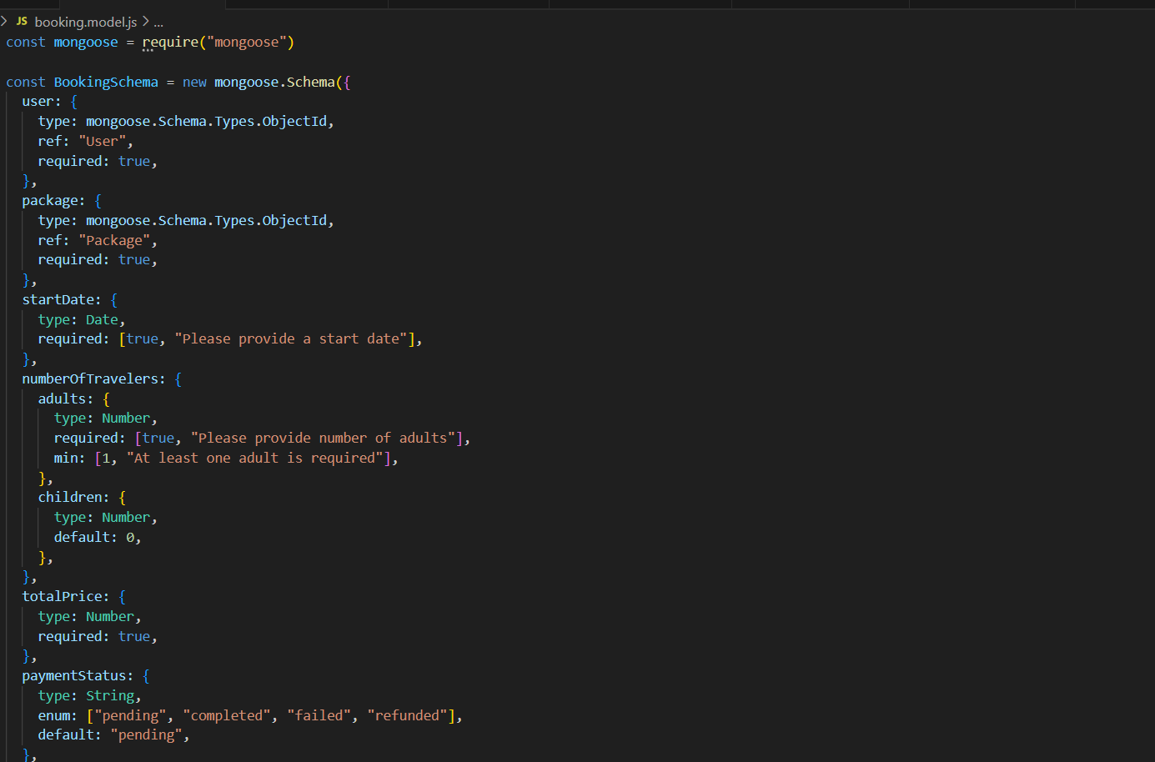
| Being Traveler

Slide 17
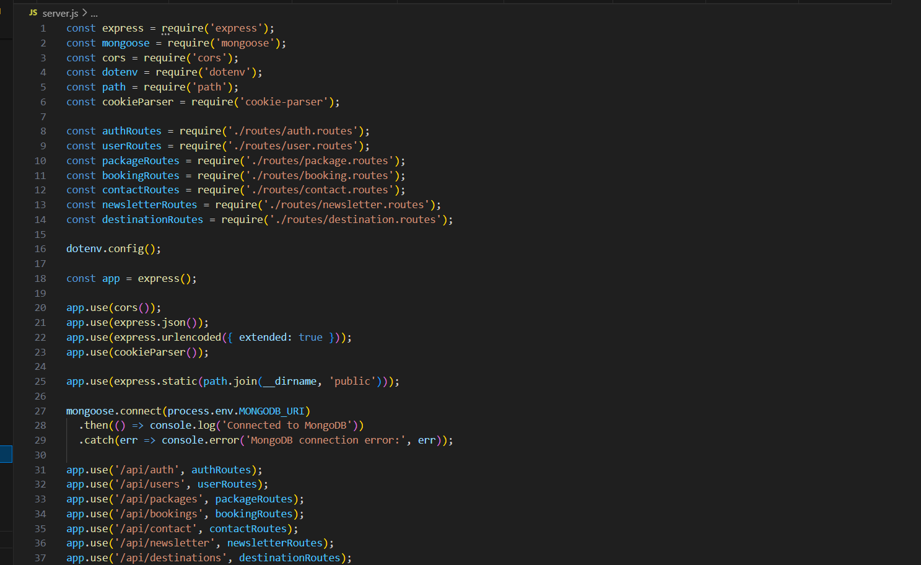
| Being Traveler

Slide 18
| Being Traveler
Authentication System:-
User registration and login functionality
JWT-based authentication for session security
Password reset functionality
Role-based access control (user/admin roles implemented)

Slide 19
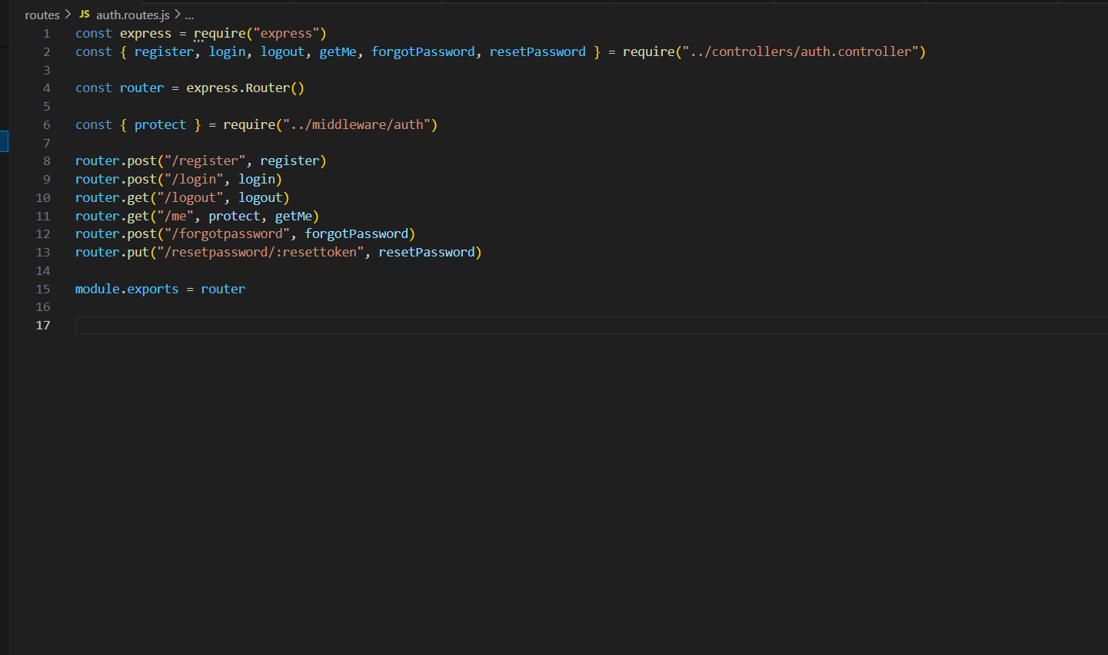
| Being Traveler

Slide 20
| Being Traveler
Data Models:-
User model with authentication methods
Package model with reviews and ratings
Destination model with detailed information
Booking model with payment tracking system
Contact and Newsletter models for inquiries and subscriptions

Slide 21
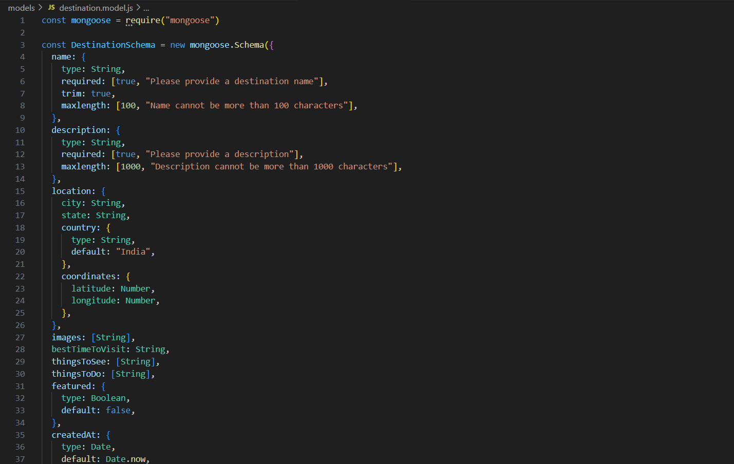
| Being Traveler

Slide 22
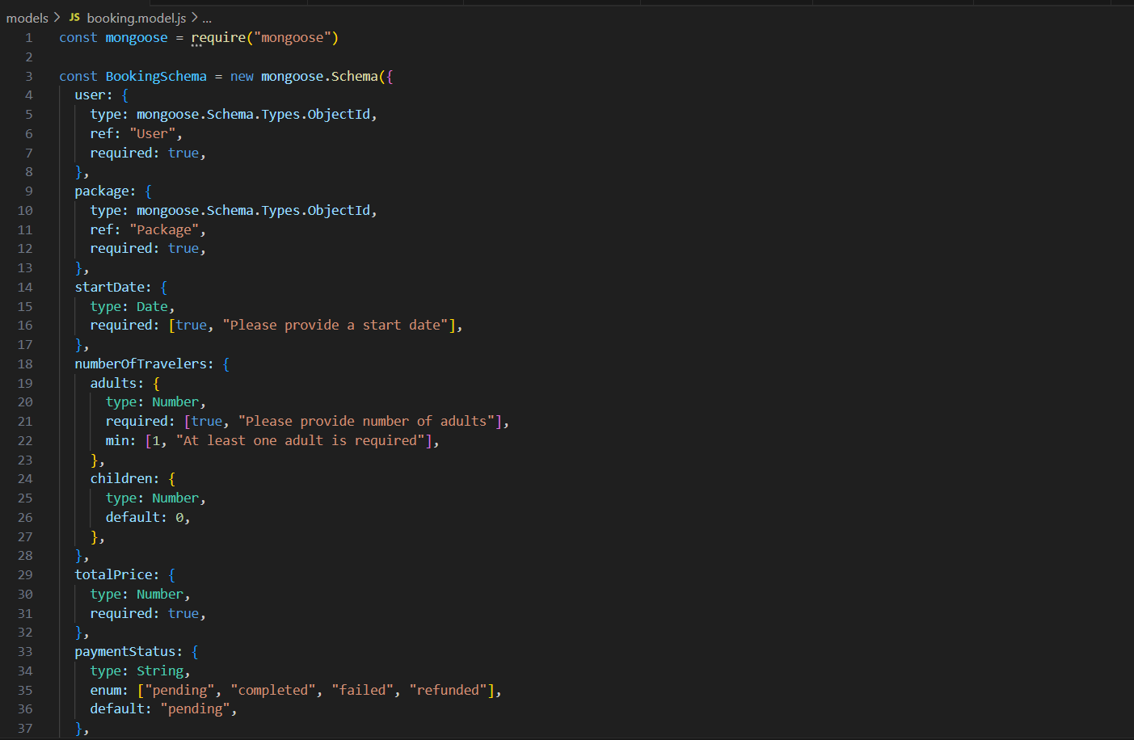
| Being Traveler

Slide 23
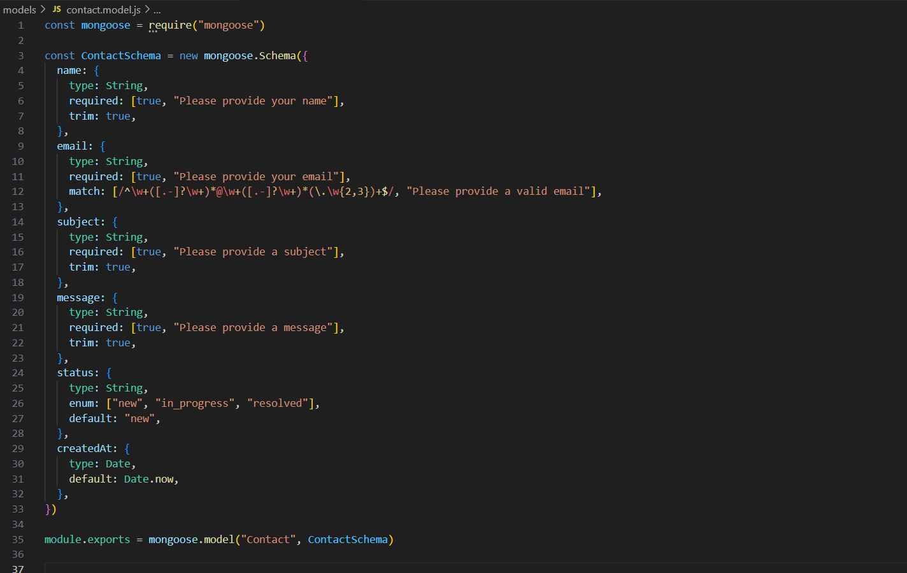
| Being Traveler

Slide 24
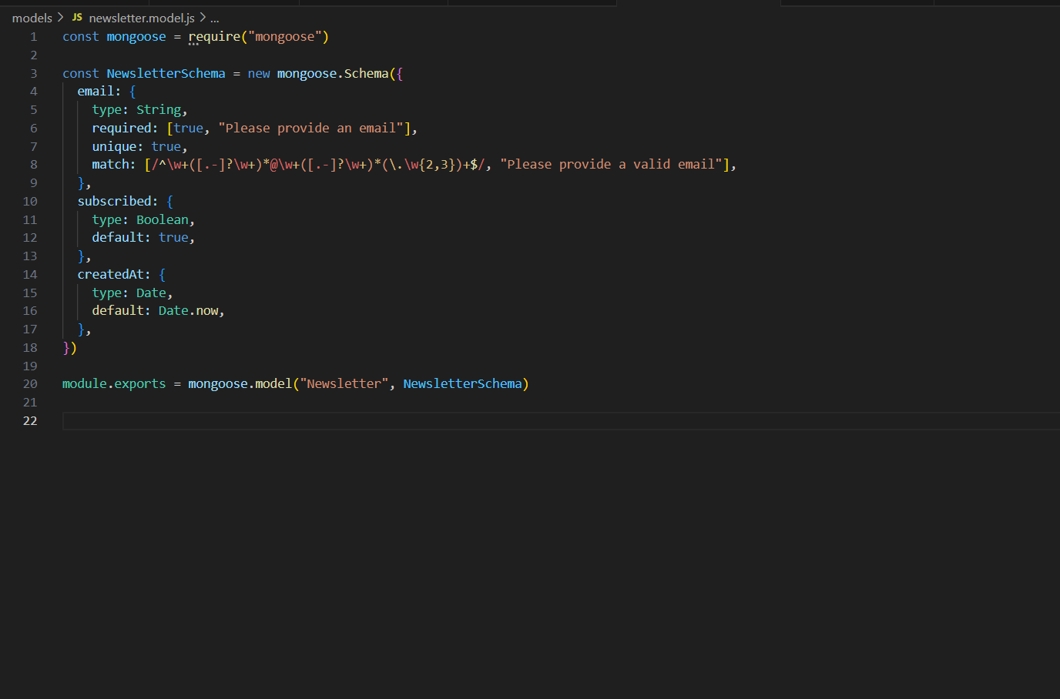
| Being Traveler

Slide 25
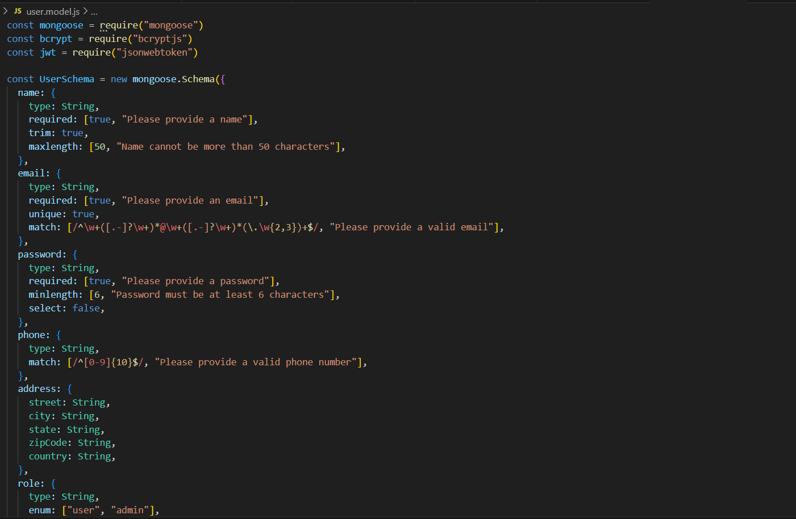
| Being Traveler

Slide 26
| Being Traveler
API Routes:-
Authentication endpoints (register, login, reset password)
Package management endpoints
Destination management endpoints
Booking system endpoints
Contact form and newsletter endpoints
Data Seeding
Sample destinations dataset (Indian locations)
Preloaded tour package data with categories
Test user accounts created for development

Slide 27
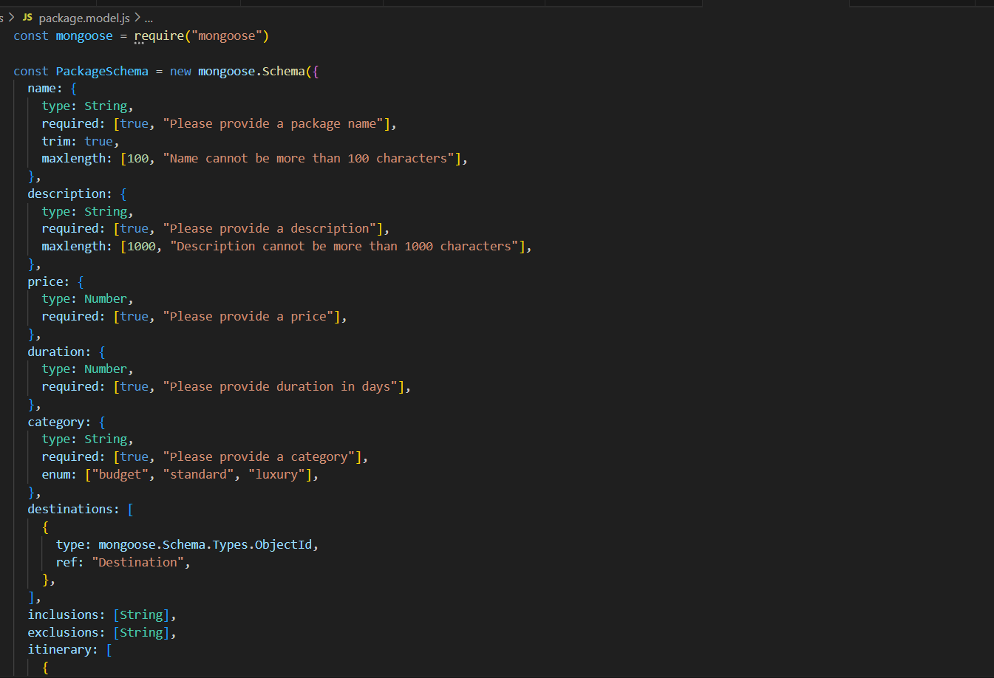
| Being Traveler

Slide 28
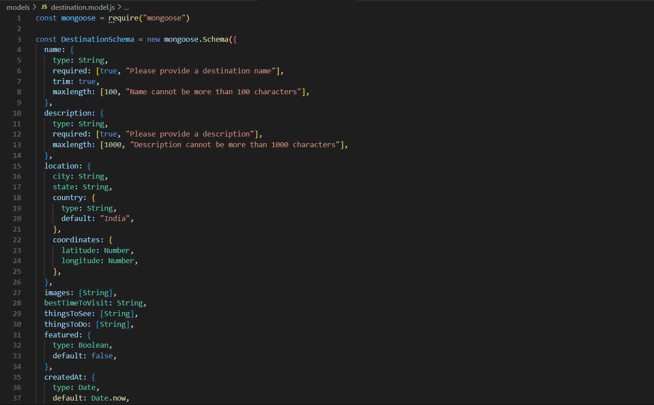
| Being Traveler

Slide 29
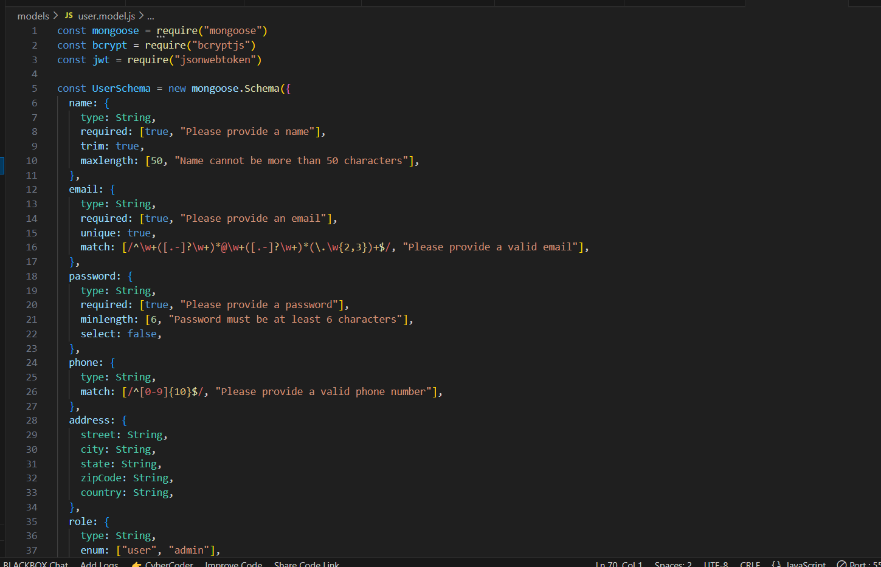
| Being Traveler

Slide 30
| Being Traveler
In Progress Components:-
Frontend Development:
Package Details Page:
Detailed view of individual tour packages
Itinerary display section
Booking form integration
User Dashboard
Booking history display
Profile management functionalities
Saved packages feature

Slide 31
| Being Traveler
Backend Development:-
Payment Integration:
Payment gateway connection
Secure transaction processing
Receipt generation
Email Notification System:
Automated booking confirmations
Payment receipts
Newsletter distribution system

Slide 32
| Being Traveler
Pending Components:-
Frontend Development
Admin Dashboard:
Package management interface
Booking management system
User management panel
Analytics and reporting dashboard
Review System UI:
User review submission interface
Rating display component
Review moderation functionality for admins

Slide 33
| Being Traveler
Backend Development:-
Advanced Search Functionality:
Search by multiple criteria (location, budget, category, etc.)
AI-powered recommendation engine for personalized suggestions
Analytics System:
User behaviour tracking implementation
Conversion metrics analysis
Performance reporting dashboard

Slide 34
| Being Traveler
Technical Challenges & Solutions:-
Challenge | Solution/Status
Mobile Responsiveness | Implemented responsive design with media queries and flexible layouts
Authentication Security | Secured using JWT with HTTP-only cookies and bcrypt for password hashing
Data Relationships | Created MongoDB schemas with proper references between collections
Image Management | Currently using placeholders; need to integrate cloud storage solution (AWS S3/Cloudinary)

Slide 35
| Being Traveler
Conclusion:-
The Being Traveler project is progressing well, with most core functionalities implemented and operational. The frontend is largely complete, offering a responsive and user-friendly interface showcasing Indian travel destinations and packages. The backend has a robust structure, including authentication, data models, and API endpoints.
The key focus areas in the upcoming weeks include:
Completing the booking system with integrated payment processing.
Developing user and admin dashboards for seamless management.
Implementing the email notification system for user engagement.

